Slide 1
Notes For Reuse
This presentation is intended to be used along side demonstrating the functionality with a live JIRA instance.
The workflow on p15 will probably be out of date (It has no Annotation Review step)

Slide 2
Sample Tracking with JIRA
Peter Edworthy

Slide 3
JIRA Terminology

Slide 4
Terms
Sample / 'Issue'
Issue is JIRA's central concept
Each sample is an issue
Issues have a 'status', a 'resolution' and an 'Assignee'
Issues can also have 'custom fields' such as BAC ID
'Sub-Tasks'
Issues that only exist within another, larger, issue.
Used for activities
Start
Finish
End
Start Again

Slide 5
Terms (cont)
'Steps'
The building blocks of workflows
A STATUS is associated with each step.
'Transitions'
Link the steps
Start
Finish
End
Start Again

Slide 6
JIRA Features

Slide 7
Search/Filters

Slide 8
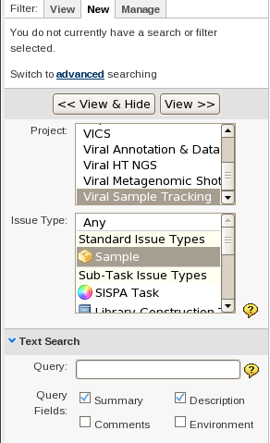
Search
Search forms the basis for much of JIRAs advanced functionality

Slide 9
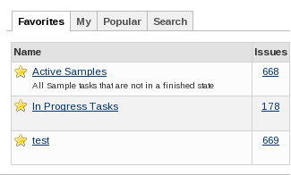
Filters
The base method of selection, used in nearly every part of JIRA
Filters are:
  Saveable
  Shareable

Slide 10
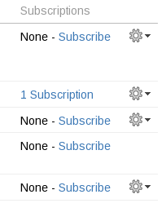
Subscriptions
CRON for Searches
Subscriptions are:
  Run at variable intervals
  Email their results
  Multiple people can 'subscribe' to filter

Slide 11
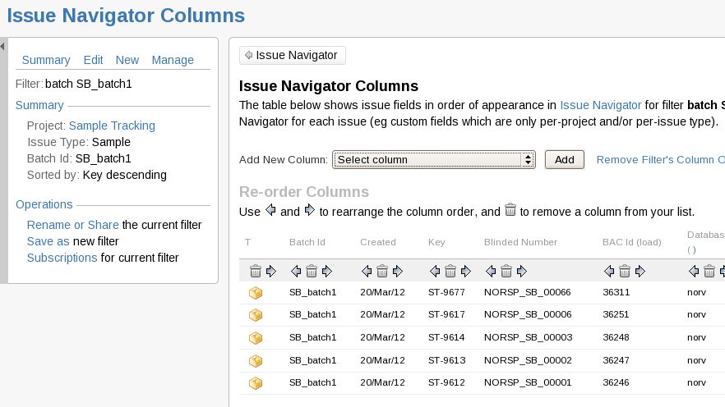
Navigator Views

Slide 12
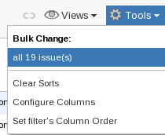
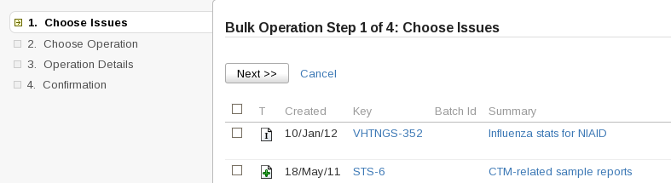
Bulk Actions
Important for Sample Tracking and handling hundreds of Issues
For Sample Tracking only two operations are used:
  Edit
  Transition

Slide 13
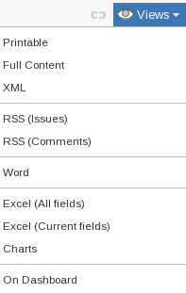
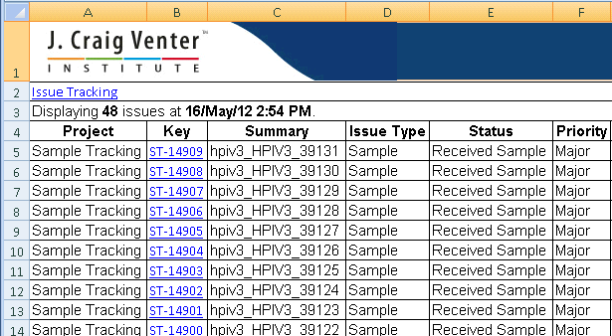
Views
An easy way to export data for one off uses

Slide 14
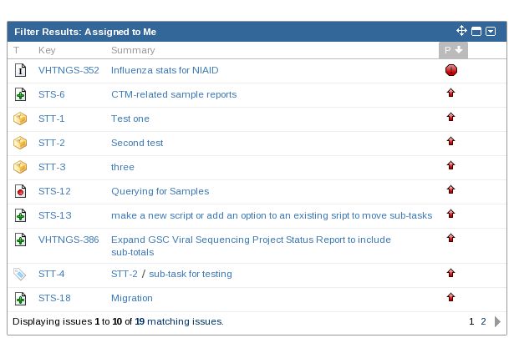
Dashboard

Slide 15
Workflow
Annotation Handover
Collaborator Review Wait
Deliver Data Email GenBank
Submitted to Genbank Wait for Response
Sample Published

